Slide 1
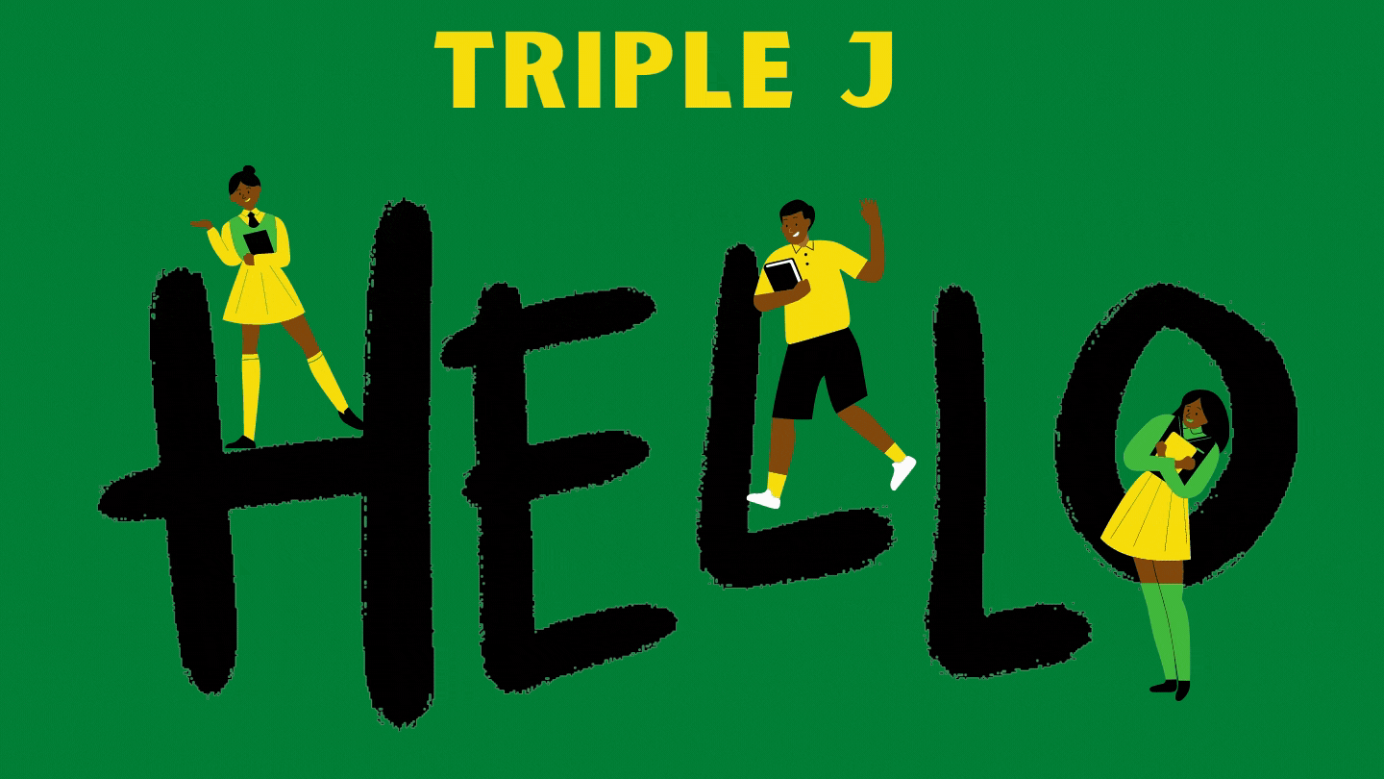

Slide 2
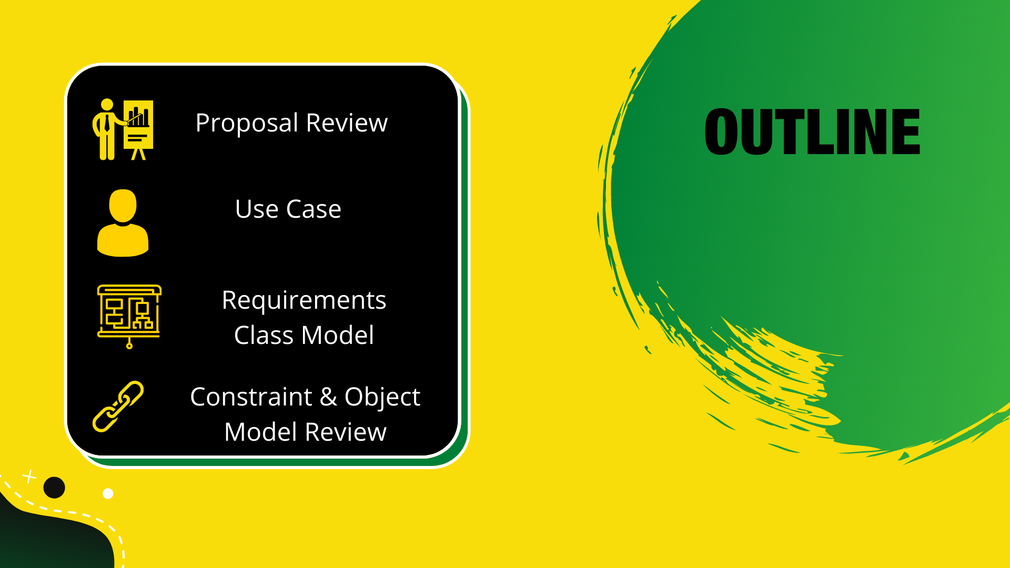

Slide 3




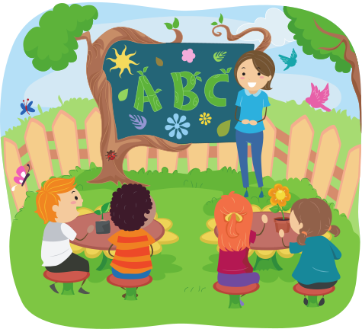


We Propose:
TutorJA
Supplimenting the Traditional Learning Experience

Slide 4




EDUCATION FOR THE FUTURE
Bridging the gap through technology

Slide 5
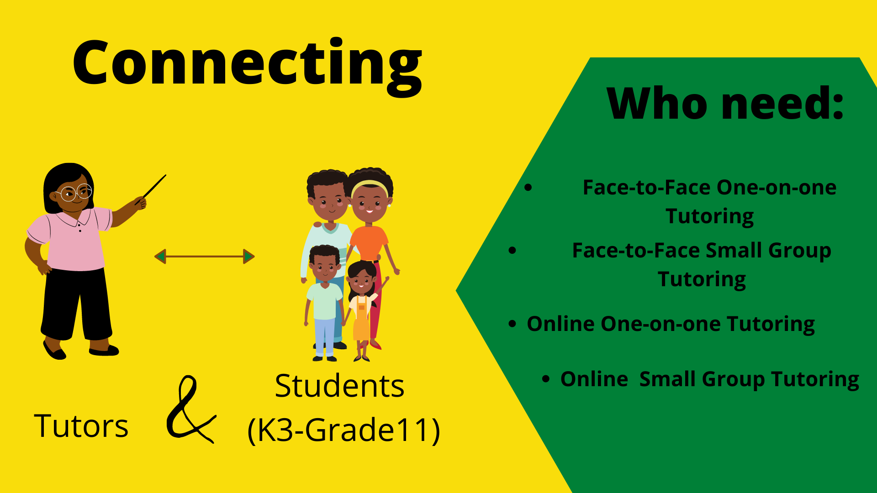

Slide 6
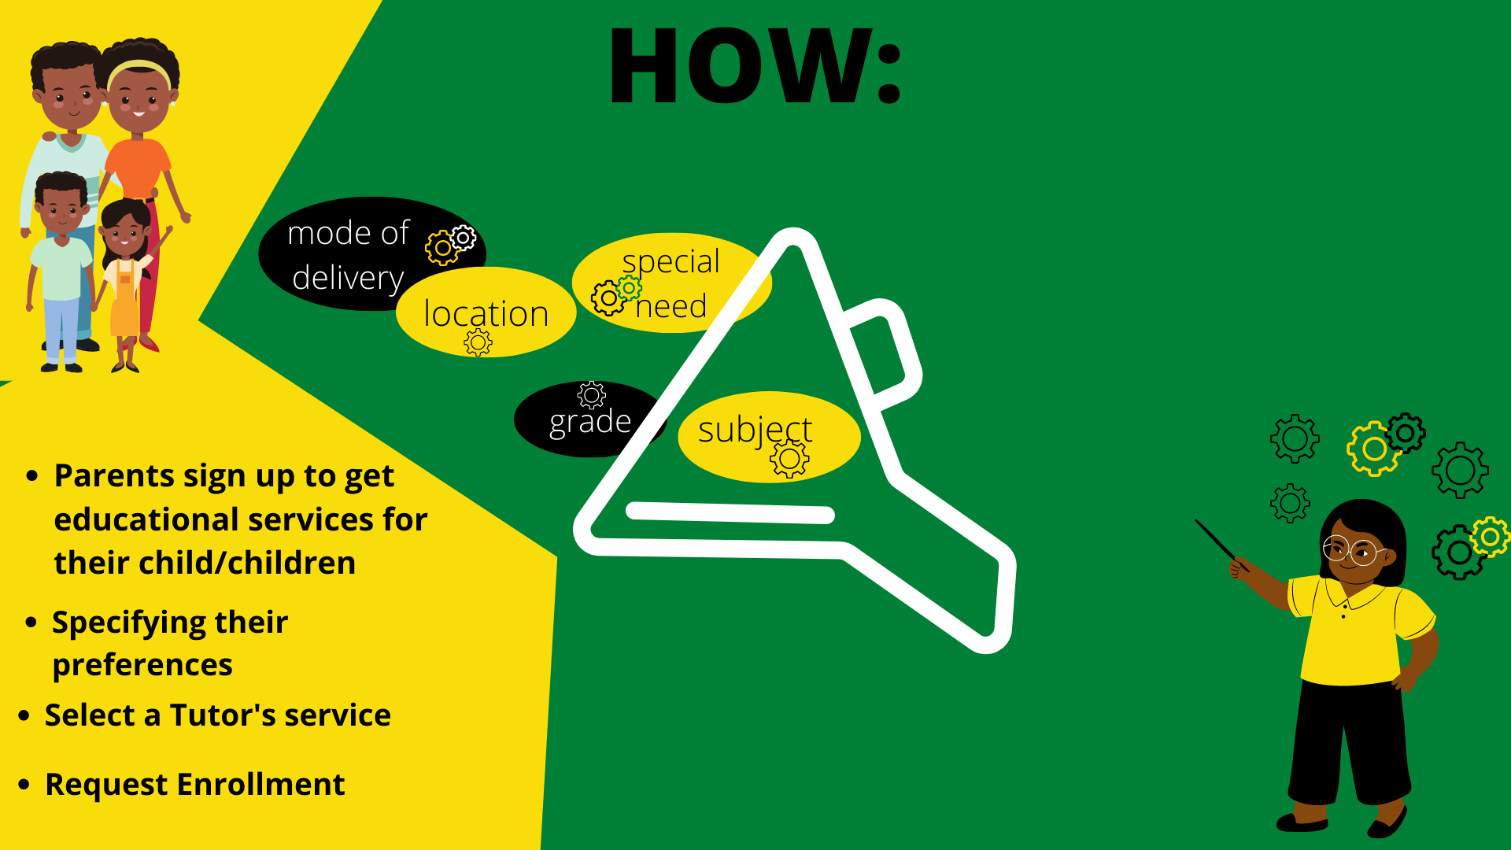

Slide 7





Use Case Model

Slide 8
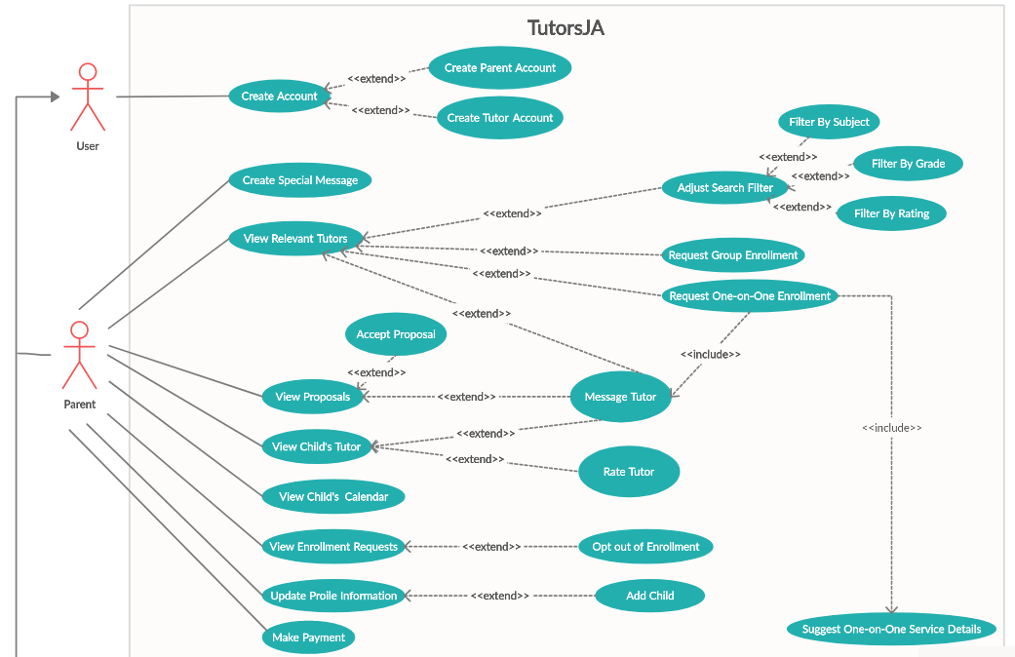

Slide 9
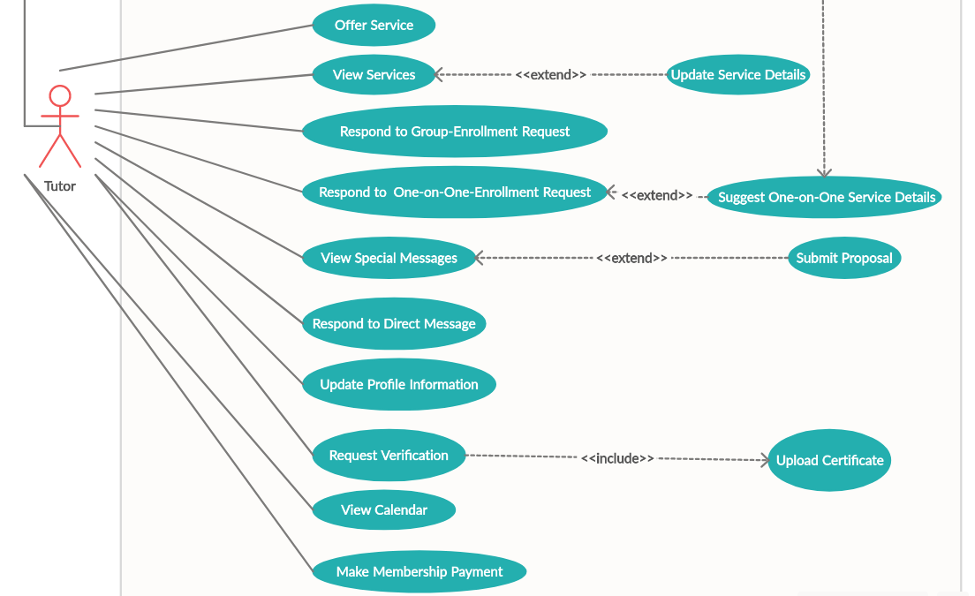

Slide 10



REQUIREMENT CLASS MODEL

Slide 11
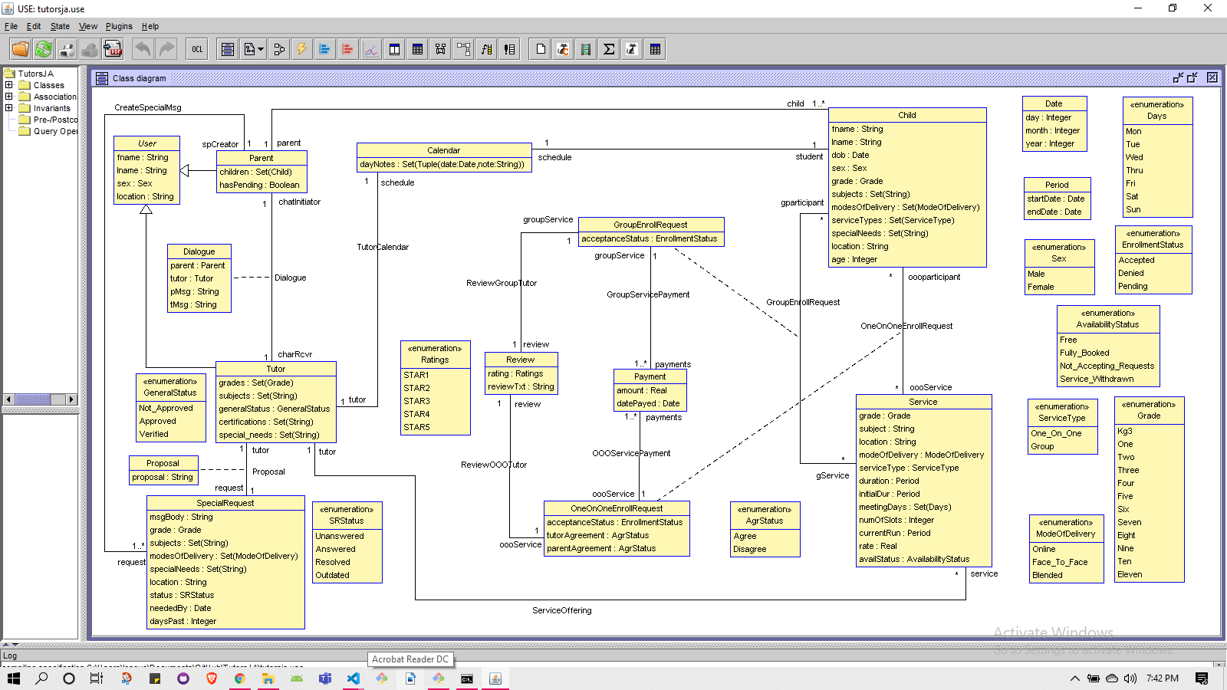

Slide 12

CONSTRAINTS
&
OBJECT MODEL REVIEW

Slide 13
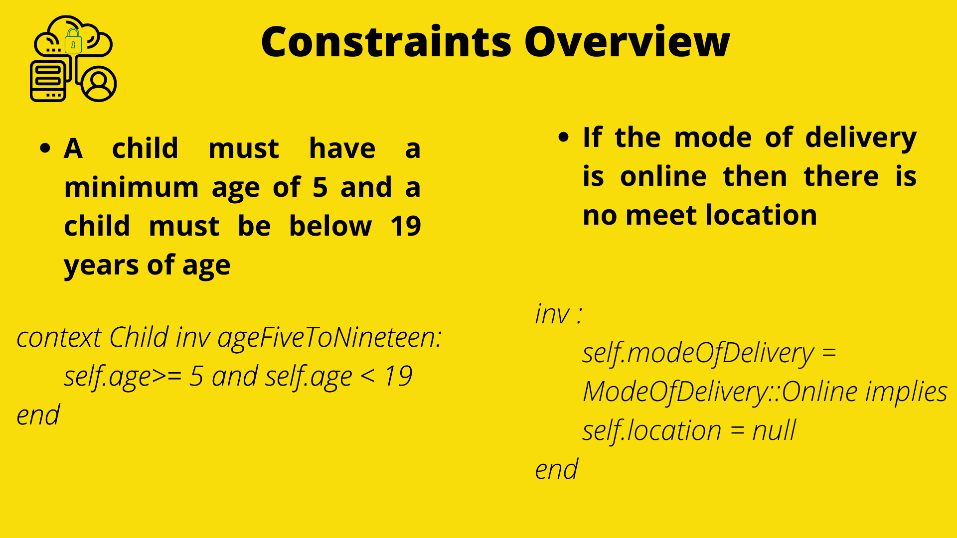

Slide 14
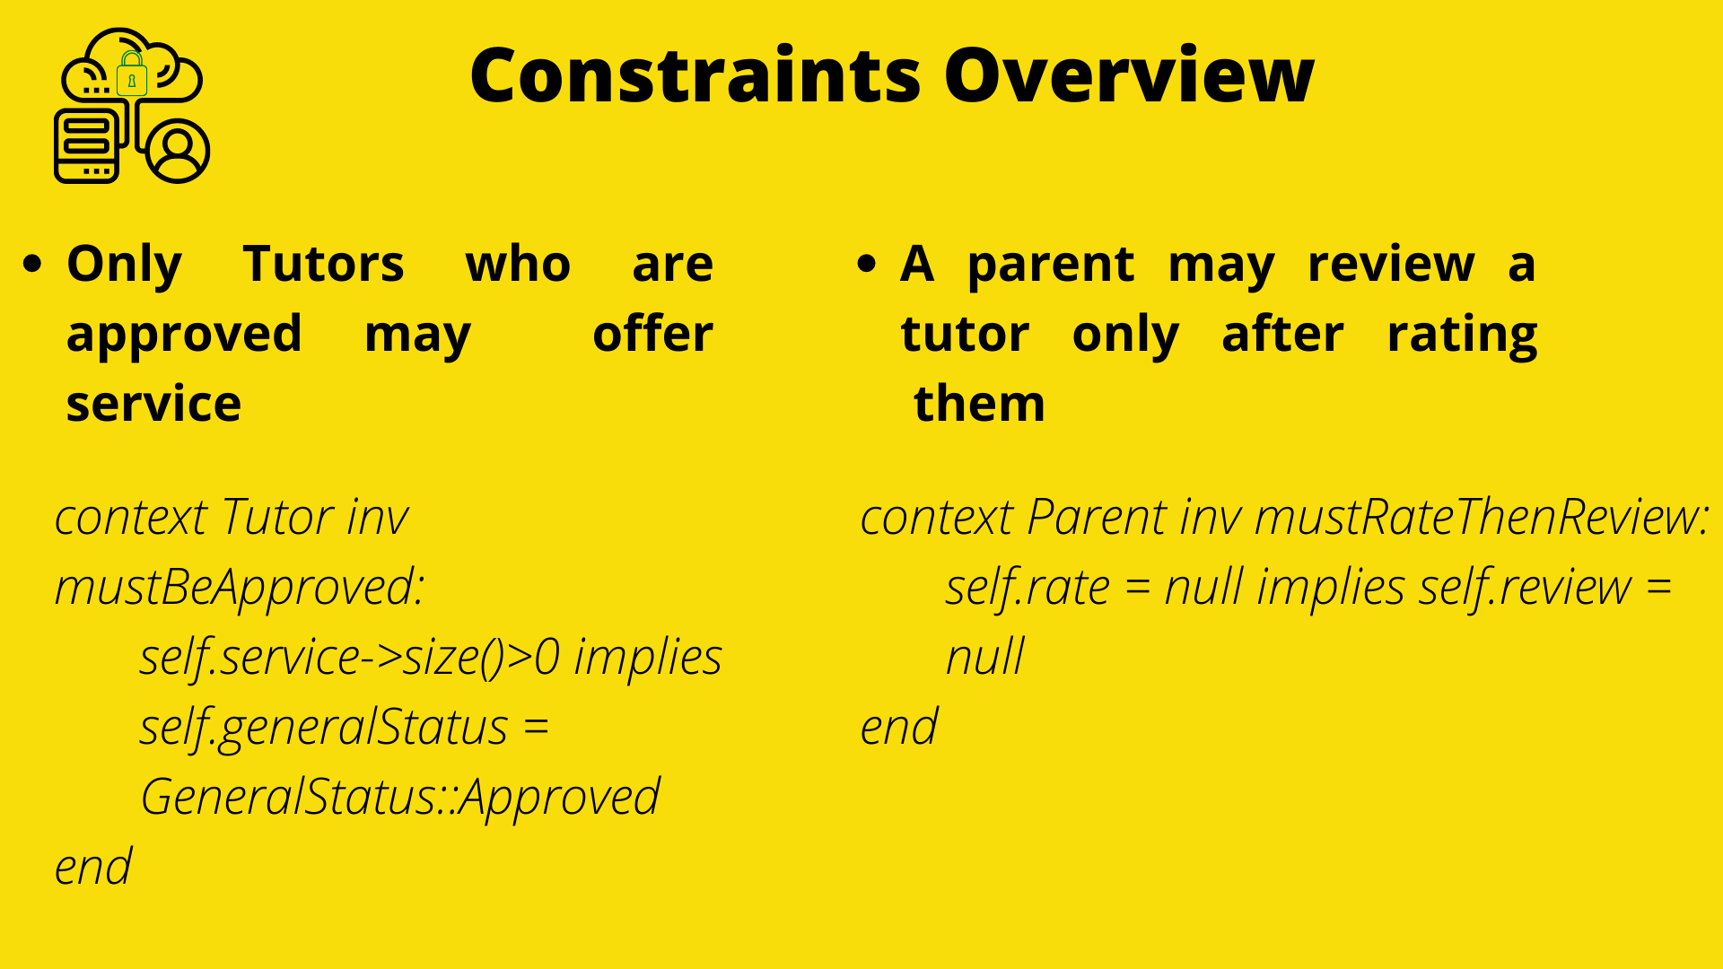

Slide 15
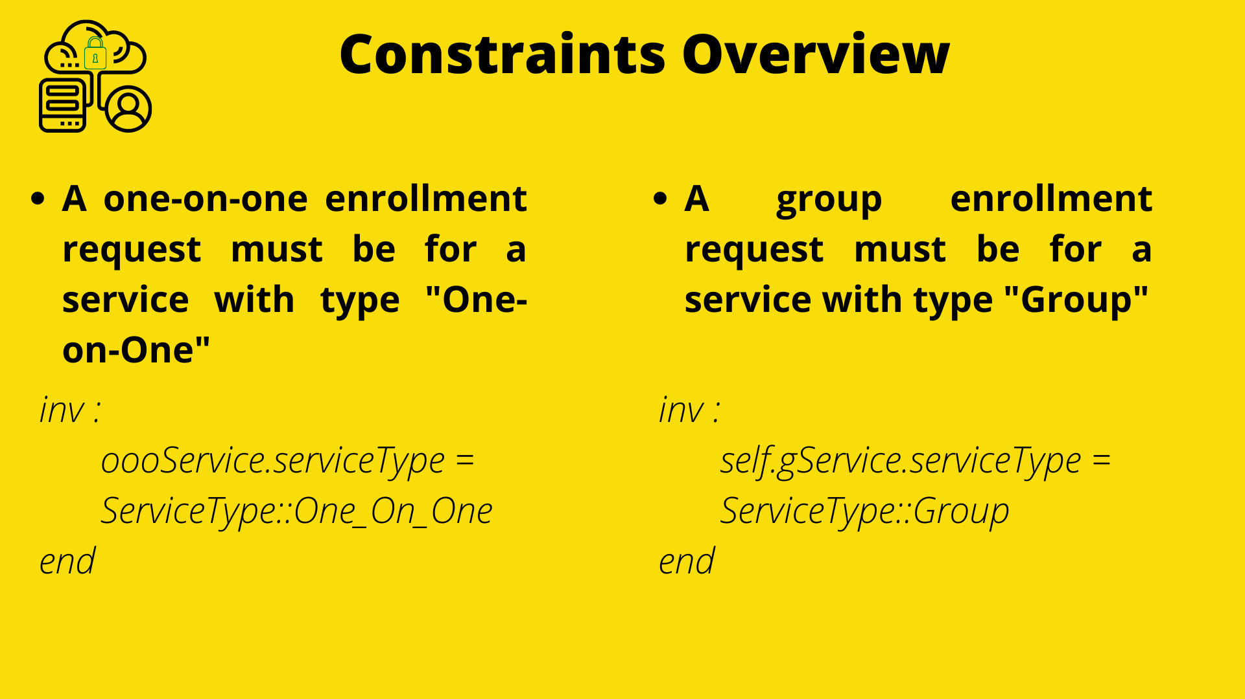

Slide 16
OBJECT MODEL REVIEW

Slide 17
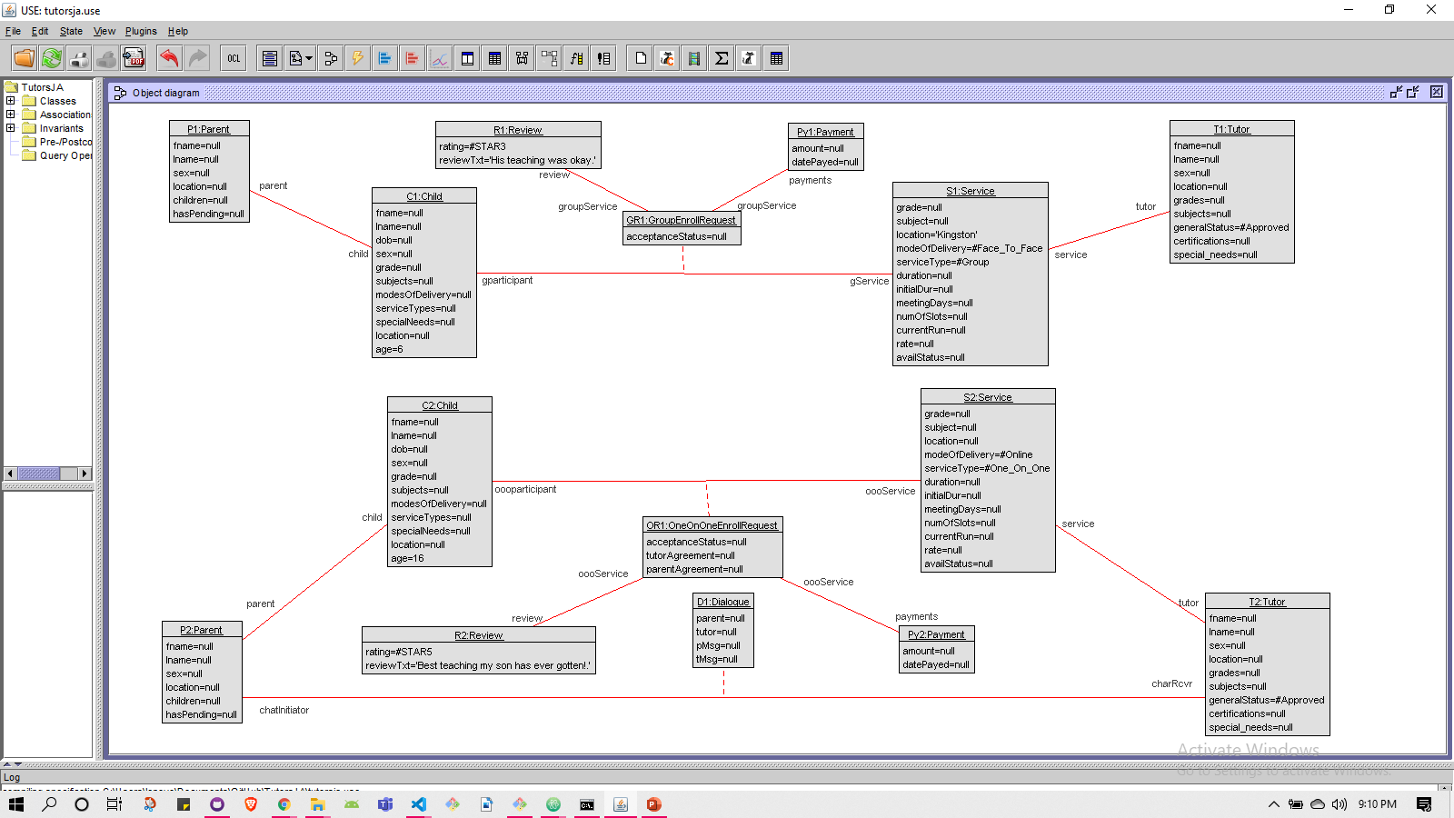
Notes:
Model showing adherence to constraints

Slide 18
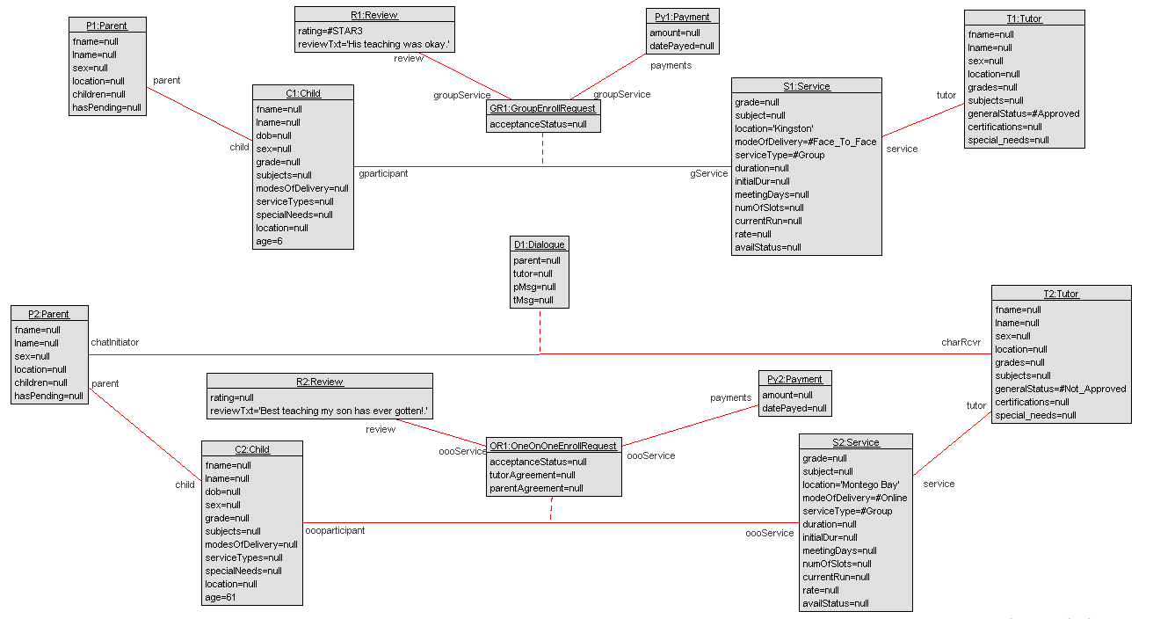

Slide 19


Demo

Slide 20





